Slide 1
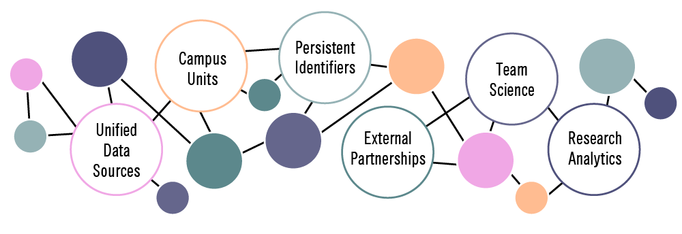
Welcome!

Slide 2
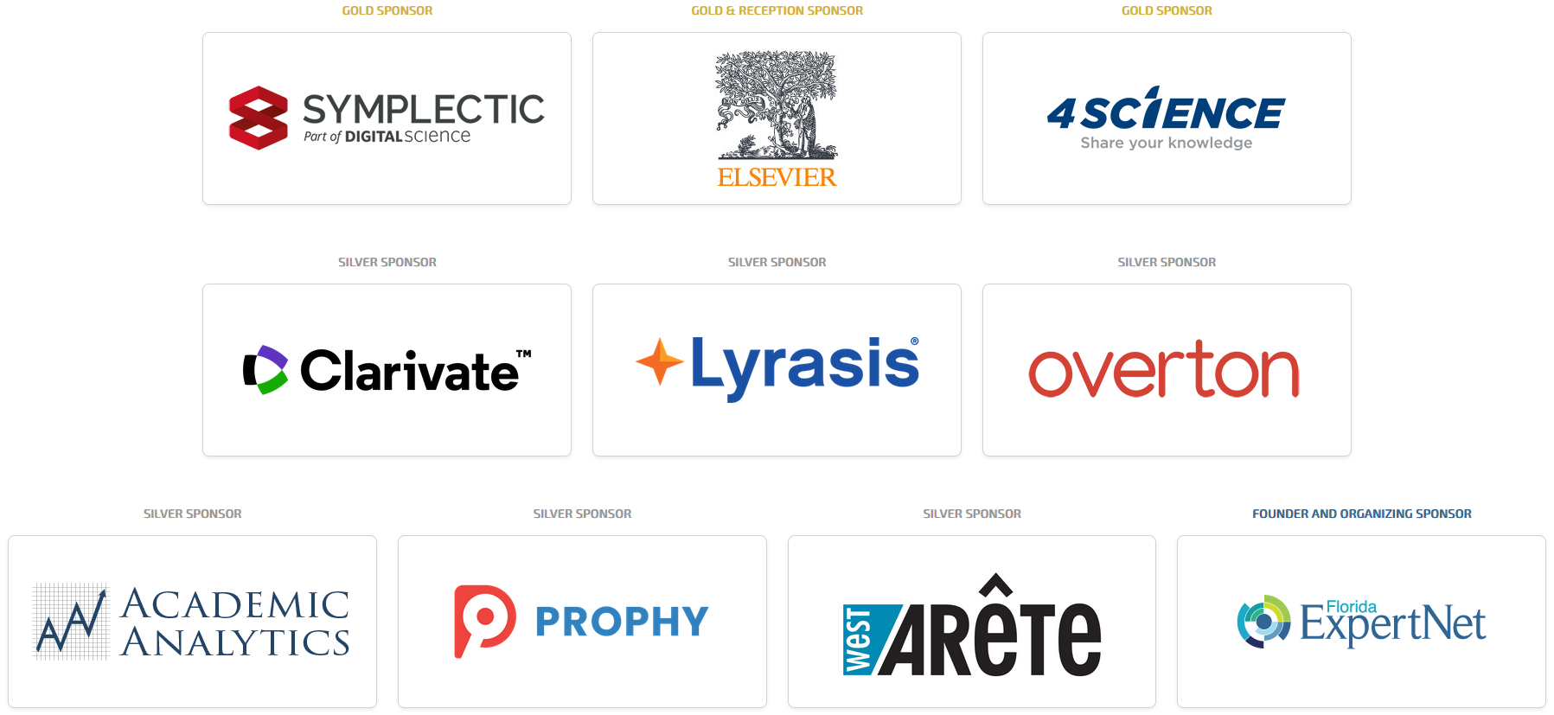
Our Sponsors

Slide 3
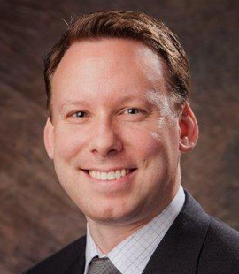
Keynote: Connecting the Dots through Career Learning, Active Engagement, and Building a Thriving Research Enterprise... A Journey Anyone Can Take!
Baron Wolf
Assistant Vice President for Research & Director of Research Analytics
Chief of Staff, Office of the Vice President for Research
University of Kentucky

Slide 4
Meet Our Gold Sponsor:
Elsevier
Patrick Crisfulla
Vice President, Research Information Solutions

Slide 5
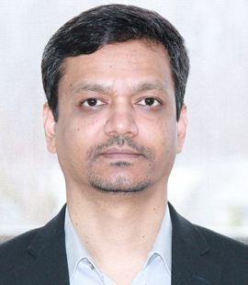
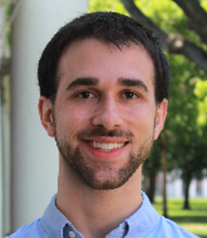
Implementing a Unified Faculty Activity Reporting System at Virginia Tech
Abhay Joshi
Director of Analytics
Virginia Tech
Ben Greenawald
Data Scientist, Office of Analytics and Institutional Effectiveness Virginia Tech

Slide 6
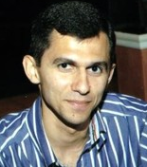
Meet Our Silver Sponsor:
Prophy Science
Oleg Ruchayskiy
Co-founder

Slide 7
Break

Slide 8
Our Sponsors

Slide 9
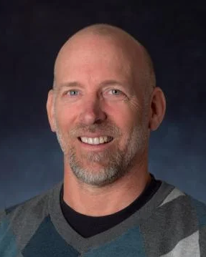
.net, .com, .edu – Connecting the Dots to Recycle and Reuse Scholarly Data within CU Boulder’s (de-facto) RIM System
Don Elsborg
FIS Systems Lead Architect
University of Colorado Boulder

Slide 10
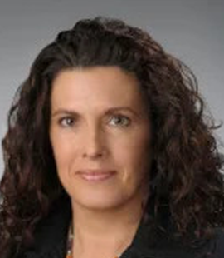
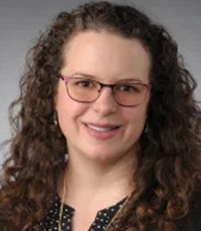
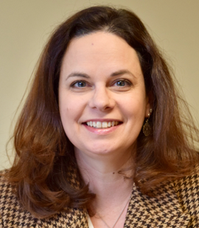
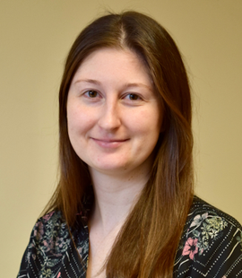
It Takes a Village: Equitable Collection and Reflection of Scholarship in Faculty Information and Expert Finder Systems
Christina Leigh Docteur
Director of Proposal Support Services, Syracuse University
Emily Hart
Science Librarian & Research Impact Lead
Syracuse University
Melissa Lowry
Assistant Director, Academic Affairs
Syracuse University
Victoria Weber
Academic Affairs Analyst, Academic Affairs
Syracuse University

Slide 11
Lunch

Slide 12
Our Sponsors

Slide 13
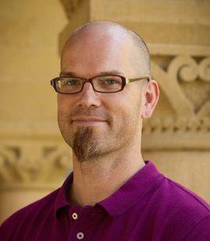
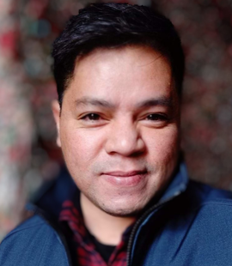
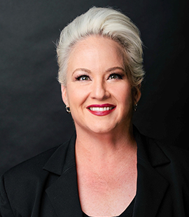
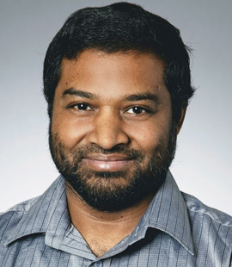
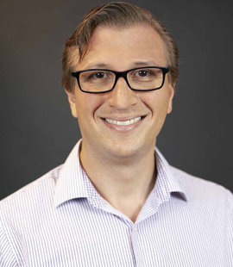
Connecting the Dots for FAIRness and Impact with ORCID (and Other Persistent Identifiers)
Zach Chandler
Director of Research Information Technology and Innovation Stanford University
Paolo Gujilde
ORCID US Community Specialist Lyrasis
Lori Schultz
Assistant Vice President, Research Intelligence
University of Arizona
Iqbal Hossain
Director, Research Data Science University of Arizona
Clarke Iakovakis
Scholarly Services Librarian
Oklahoma State University

Slide 14
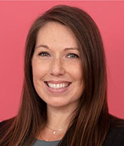
Meet Our Silver Sponsor:
Clarivate
Sara Branch
Technical Solutions Consultant

Slide 15
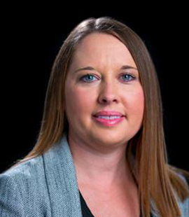
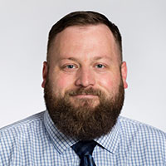
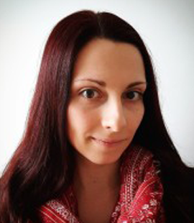
Supporting and Informing Users: Developing User Information Portals and Training Resources
Stephanie Thompson
Strategic Initiative Associate University of Kentucky
Dave Scherer
Customer Consultant, Pure & Data Monitor
Elsevier
Irina Bischof
Senior Product Manager, Pure Elsevier

Slide 16
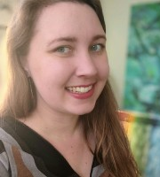
Meet Our Silver Sponsor:
Overton
Mirage Berry
Director of Business Development (Americas)

Slide 17
Break

Slide 18
Our Sponsors

Slide 19
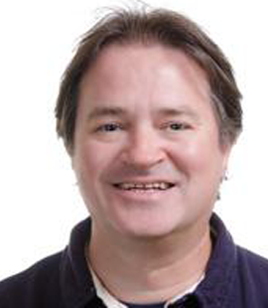
GradWorld FSU Interactive Video Archive
Mark Riley
Dean of the Graduate School Florida State University

Slide 20
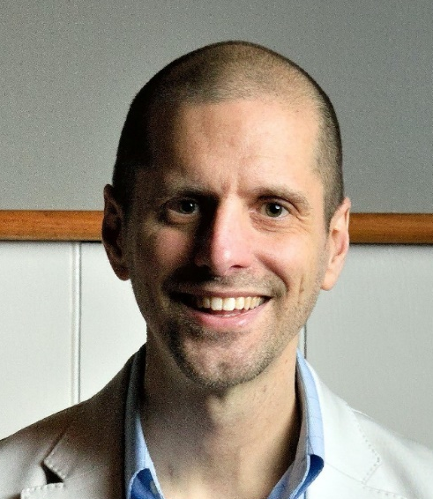
Meet Our Silver Sponsor:
West Arete
Scott Woods
Founder & CEO

Slide 21
World Café Discussion

Slide 23
Welcome!

Slide 24
Our Sponsors

Slide 25
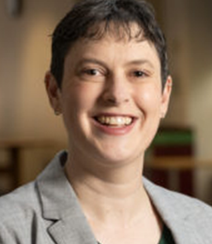
Keynote: Vision of Self, Serendipitous Collaborations, and Institutional Pride
Karen Estlund
Dean of Libraries
Colorado State University

Slide 26
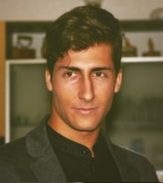
Meet Our Gold Sponsor:
4Science
Federico Verlicchi
Business Developer

Slide 27
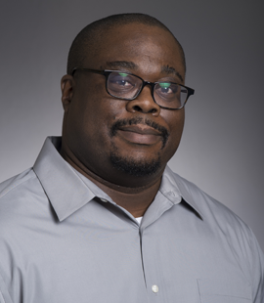
Strategies for Building Reporting and Data Visualization Services around RIMS and Expert Finder Systems
Jason Glenn
Director, Research Information Management Services
Carnegie Mellon University Libraries

Slide 28
RIM System Implementation & Management with a Small Team of Librarians: Challenges & Opportunities
Clarke Iakovakis
Scholarly Services Librarian Oklahoma State University

Slide 29
Break

Slide 30
Our Sponsors

Slide 31
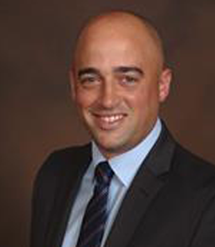
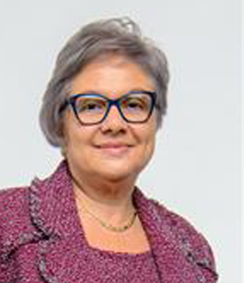
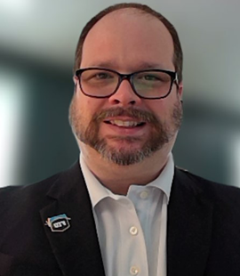
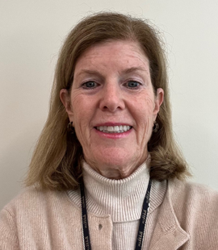
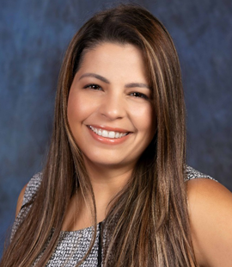
Information Management Principles and Practices You Need to Connect the Dots
David W Driesbach
Assistant Vice President, Research Florida International University
Yesim Darici
Professor of Physics, and Associate Vice Provost for Faculty Development and STEMM
Florida International University
Robert Gutierrez
Associate Vice President, Research, Office of Research and Economic Development & University Graduate School, FIU
Maureen Pelham
Director, Research Development, Director of Postdoctoral Scholar Services
Florida International University
Abilene Pinzon
Director, Academic Support Services
Florida International University

Slide 32
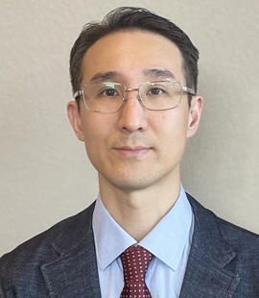
The Structure and Priorities of Researchers’ Scholarly Profile Maintenance Activities: A Case of Institutional Research Information Management System
Dong Joon Lee
Associate Professor
Texas A & M University
Besiki Stvilia
Professor
Florida State University

Slide 33
Lunch

Slide 34
Our Sponsors

Slide 35
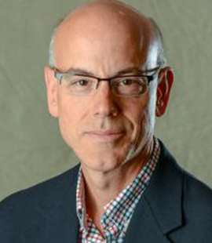
Keynote: Building an Ecosystem of Innovation in Ohio
and Beyond
Jeff Agnoli
Senior Liaison, Ohio Innovation Exchange
Ohio Department of Higher Education

Slide 36
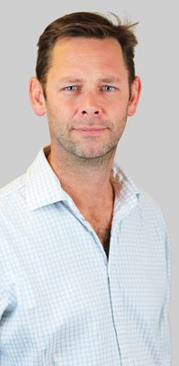
Meet Our Gold Sponsor:
Symplectic, Part of Digital Science
Nick Anderson
Senior Product Manager

Slide 37
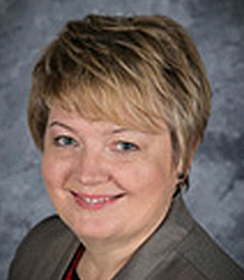
University Expert Web Portal as a Sustainable Part of the State-wide Innovation Ecosystem
Iryna V Lendel
Senior Director of Regional Economic and Community Development
The W. E. Upjohn Institute for Employment Research

Slide 38
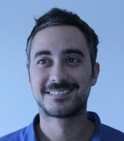
Meet Our Silver Sponsor:
Lyrasis
Michele Mennielli
Senior Global Strategist

Slide 39
Break

Slide 40
Our Sponsors

Slide 41
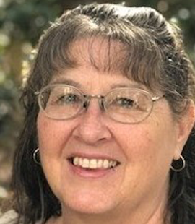
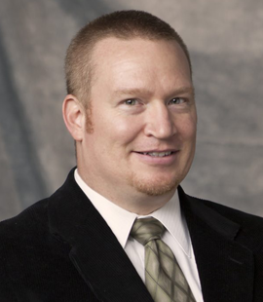
Focusing Discovery and Awareness: The Use of RIM Systems for Internal and External Research Communication Initiatives
Bonnie Crotty Nelson
Proposal & Information Specialist Research Triangle Institute
Baron Wolf
Assistant Vice President for Research & Director of Research Analytics, and Chief of Staff, Office of the Vice President for Research University of Kentucky
Mark Zulauf
Researcher Information Systems Coordinator
University of Illinois Urbana-Champaign
David Scherer
Customer Consultant, Pure and Data Monitor
Elsevier

Slide 42
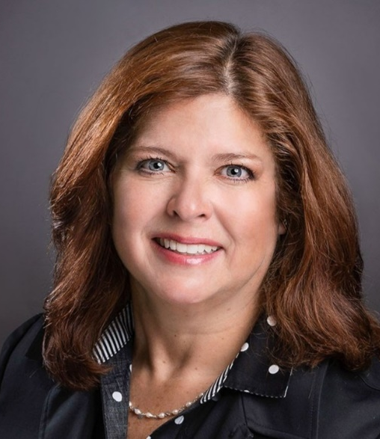
Meet Our Silver Sponsor:
Academic Analytics
Stephanie Faulkner
Vice President for Product Development

Slide 43
Closing

Slide 44
Our Sponsors

